Slide 1
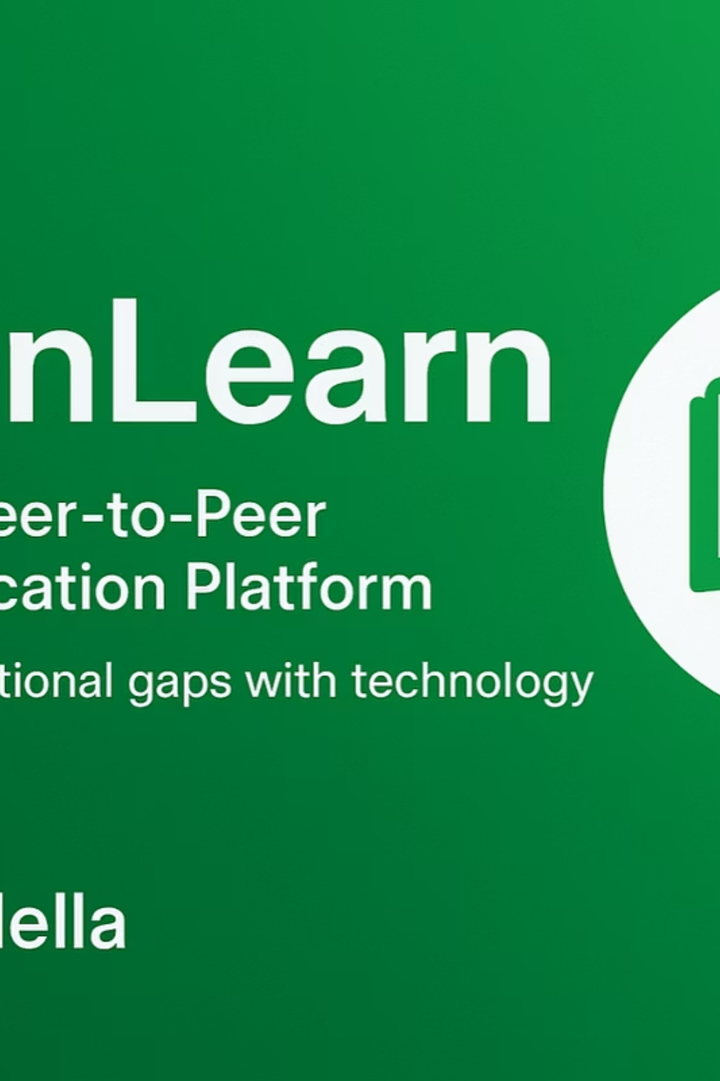
OpenLearn: Inclusive Peer-to-Peer Digital Education Platform
Welcome to OpenLearn, an innovative initiative dedicated to democratizing access to quality education. We believe every learner, regardless of their background or location, deserves the opportunity to thrive in a digital world.

Slide 2

Addressing the Global Learning Gap
Despite advancements, significant barriers prevent equitable access to quality education worldwide. OpenLearn directly confronts these challenges.
Limited Access to Education
Digital Divide & Resource Scarcity
Many underserved communities lack the foundational resources and infrastructure for comprehensive learning, hindering potential.
An increasing reliance on digital learning exacerbates the gap for those without internet access or adequate educational materials.
Insufficient Academic Support
Students often struggle without personalized guidance, mentorship, and additional academic assistance beyond the classroom.

Slide 3




OpenLearn's Empowering Solutions
We offer a multi-faceted approach to bridge educational disparities and foster a culture of continuous learning.
Peer-to-Peer Tutoring
Digital Resource Hub
Connecting learners with peers for collaborative study sessions and personalized academic support.
A centralized repository of free, high-quality educational materials accessible to everyone, everywhere.
Lifelong Learning Campaigns
Promoting the value of continuous education through engaging community outreach and awareness initiatives.

Slide 4

Our Core Strategic Objectives
OpenLearn is driven by clear goals designed to create measurable impact and foster educational equity.
1
Facilitate Peer-to-Peer Tutoring
Enable dynamic knowledge sharing, mentorship, and collaborative learning environments among students.
2
Curate & Distribute Free Resources
Develop and disseminate high-quality digital learning content, including PDFs, eBooks, and video tutorials.
3
Promote Lifelong Learning
Conduct impactful awareness campaigns that emphasize the transformative power and continuous benefits of education.
4
Ensure Inclusivity & Accessibility
Guarantee that all learners, irrespective of their socio-economic background, can access our platform and resources.

Slide 5





Platform Key Features
OpenLearn is built with intuitive features designed to maximize engagement and learning outcomes for all users.
Dynamic Study Groups
Comprehensive Resource Hub
Collaborative learning circles where students can connect, discuss, and learn from each other in real-time.
An easily navigable library of educational content, including e-books, articles, and interactive exercises.
Engaging Educational Content
Mobile-First Accessibility
A rich collection of video tutorials and step-by-step guides covering a wide range of subjects.
Optimized for mobile devices, ensuring seamless learning experiences on smartphones and tablets.

Slide 6

Robust Technology Stack
Our platform is built on a modern, scalable, and secure technology foundation to ensure optimal performance and user experience.
Frontend
Developed with HTML, CSS, JavaScript, and React for a responsive and intuitive user interface.
Backend
Powered by Node.js/Express or Firebase, providing robust server-side logic and API management.
Database
Data persistence managed by MongoDB or Firebase, ensuring flexible and efficient data storage.
Deployment
Hosted on reliable platforms like GitHub Pages, Vercel, or Netlify for continuous integration and delivery.

Slide 7

Measuring Our Transformative Impact
OpenLearn is committed to delivering tangible results and fostering positive change in educational outcomes.
100+
Free
Growth
Scalable
Students Improved
Learning Resources
Collaborative Learning
Global Reach
Projected increase in student academic performance within the first year of implementation.
Ensuring accessible, high-quality educational materials are available to all, free of charge, online.
Fostering an environment where students actively engage, share knowledge, and learn together.
Our model is designed to be easily adaptable and expandable to diverse regions and communities worldwide.

Slide 8

Connect With OpenLearn
Explore our live demo and connect with the project team to learn more about OpenLearn's mission and development.
Live Demo
GitHub Repository
openlearn-sdg4.vercel.app
SDG-4 Quality-Education Project
Experience the platform firsthand.
Access our codebase and contribute to development.
Contact & Connect
Email: edrisabdella178@gmail.com
LinkedIn: edris-abdella-nuure
GitHub Profile: Edrisabdella

Slide 9

OpenLearn's Strategic Roadmap
Our phased approach ensures sustainable growth and continuous expansion of OpenLearn's reach and offerings.
1
Phase 1 (1-3 Months)
Focus on building the core Digital Resource Hub and populating it with foundational educational content.
2
Phase 2 (4-6 Months)
Launch and refine the Peer-to-Peer Tutoring module, facilitating initial student connections and feedback loops.
3
Phase 3 (6-12 Months)
Expand the resource library, establish strategic partnerships with educational institutions and NGOs, and scale operations.

Slide 10

Our Driving Force: Team & Collaboration
OpenLearn thrives on the dedication of our team and the strength of our partnerships, united by a shared vision for global education.
1
Project Leadership
Led by Edris Abdella, guiding the vision and execution of OpenLearn.
2
Development Support
Benefiting from the expertise and technical contributions of EastEdge Engineering.
3
Community Engagement
Empowered by the invaluable contributions of our dedicated Tutors and Volunteers.
4
Strategic Partnerships
Collaborating with schools and NGOs to expand our reach and impact.

